Slide 1
Sprint 2
Michael was product owner and Chris was scrum master.
Michael, Dane, and Gabe were all tasked to each learn C# and Unity.
Chris’s task was to create base placeholder game engine for game objects.
He successfully wrote classes out and created code for the game objects, but he explained that while the code did work it was not “pretty” and may need some revisions.
Billy’s task was to draft out data diagrams and descriptions of ideal classes he wanted implemented.
He wrote diagrams showing dataflow between his ideal classes. He also wrote brief descriptions for each component.
Tasks for sprint were done, but some not finished.

Slide 2
Sprint 7
Dane was scrum master and Billy was product owner.
Gabe’s goal for the sprint was to flesh out the attack logic to select targets.
He scripted the code, but had issues getting it to work. The event system bottlenecked him.
Michael’s task was to clean up the HUD assets and implement code for them.
HUD was successfully cleaned based off group feedback, and code was scripted/tested.
Dane’s task was to spawn enemies of a different color and give enemies movement.
Enemies successfully spawn randomly on the board with their own unique models.
Billy’s task for the week was to unify the project and create more 3D models...
Sprint had some roadblocks and some successes.

Slide 3
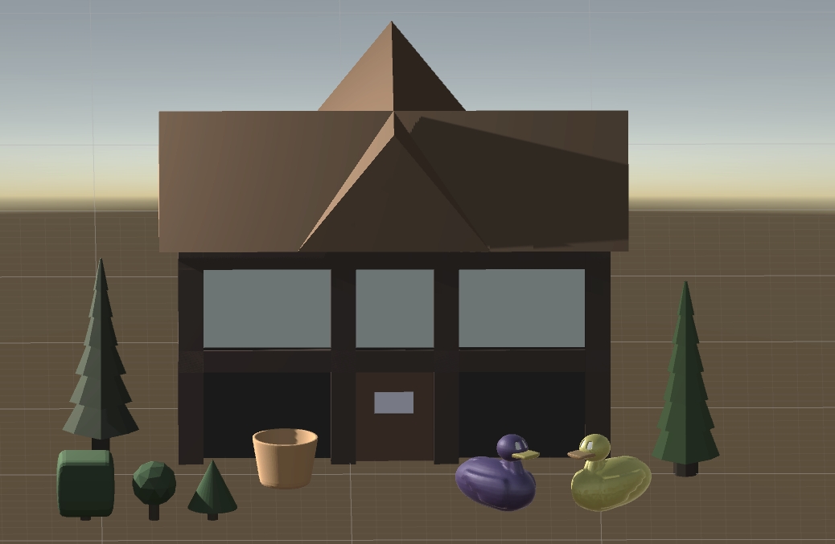
Final Product Features
Michael presents but everyone contributes

